Slide 1

MEDIA ANALYTICS
BrightTV
Viewership Analysis
Subscriber viewing behaviour, content consumption trends, and growth opportunities
Prepared by • Phathutshedzo Mpfumali

Slide 2
Project Objective
▲
★
◆
Analyze
Insight
Grow
Subscriber viewing behaviour to identify content consumption trends.
Provide actionable insights that support BrightTV's growth strategy.
Improve customer engagement and expand the subscription base.
Tools: Databricks SQL • Databricks Dashboard • Data Studio • Power Bi • Excel Pivot tables • Miro • Canva

Slide 3
Executive Summary
9 995K
Gauteng
Young Adult
Total Subscribers
Top Province
Top Age Group
Live Events
16
Top Channel
TV Channels
Viewership grew steadily Jan–Mar. Live Events and sports drove the highest engagement.

Slide 4
Monthly Subscriber Trend
+150%
Growth
Strong upward momentum from January to March.

Slide 5

Viewership by Region
Gauteng leads with 35%
Nearly double the next largest province — a clear geographic concentration.

Slide 6
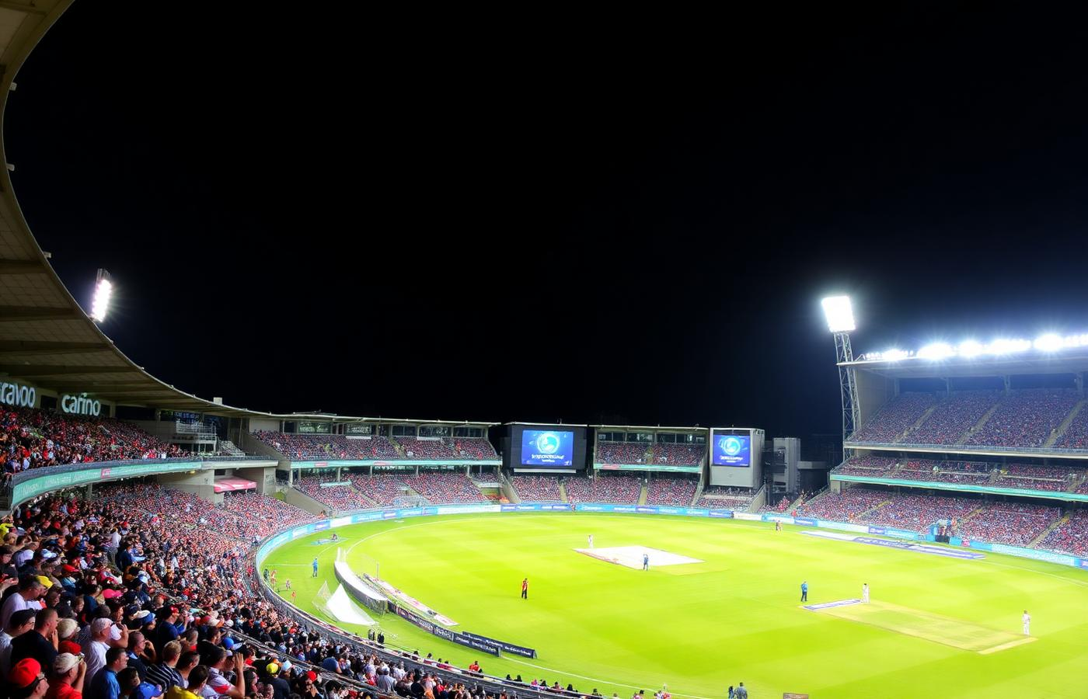
Top 5 Most Watched Channels
Live & Sports Dominate
The top two channels are event-driven, showing strong demand for live programming.

Slide 7

Age Group Distribution
Young Adults Lead — 55%
Young Adults + Adults represent 90% of total viewership.

Slide 8
Audience Composition

Slide 9
Viewer Behaviour Patterns
Evenings dominate viewing • Saturdays are peak weekly

Slide 10
Insights & Recommendations
Key Findings
Recommendations
Live Events received the most views.
ICC Cricket World Cup generated the highest watch time.
Young Adults are the largest audience segment.
Gauteng has the highest viewership.
Viewership grew steadily January to March.
Schedule premium content in peak evening hours.
Promote Live Events and sports channels aggressively.
Focus marketing on Young Adults in Gauteng.
Boost advertising in low-performing regions.
Test female-focused content to broaden reach.

Slide 11

Thank You
BrightTV • Viewership Analysis

